Slide 1
PIP104 PROFESSIONAL PRACTICE-II VIVA-VOCE
DIGITAL PUBLIC ANNOUNCEMENT AND CHAT BOT SYSTEMS
Batch Number: PSCS139
Under the Supervision of,
20221LCS0015 AMRUTH RAO P Dr. / Mr. / Ms. Pamila Vinitha Eric
20221LCS0014 G PANDURANGA Professor/Associate Professor/Assistant
20211CSE 0269 NARESH MG Professor
20211CSE0303 ADITHYA S School of Computer Science Engineering &
20211CSE0307 ULLAS S B Information Science
Presidency University
Roll Number | Student Name

Slide 2
INTRODUCTION
The "Digital Public Announcement and Chat Bot Systems" project introduces a groundbreaking method for disseminating information within public spaces. Leveraging Next.js for the frontend and Node.js with Socket.IO for real-time communication, the system is built to enhance how users interact with public services. It integrates AI for natural language processing, providing features such as real-time public announcements and a video support system, making information and assistance readily available.
A notable aspect of this project is its focus on user experience, accessibility, and security. The interfaces are designed to be intuitive and accessible to a wide range of users, ensuring that information is not just delivered but also comprehended. Security measures are in place to protect user data, with TypeScript ensuring the codebase remains robust and maintainable, thereby reducing vulnerabilities over time.

Slide 3
Literature Review
Title: "AI Chatbots in Public Sector Communication"
Author: J. Smith
Algorithm Used: Natural Language Processing (NLP)
Drawbacks: Limited understanding of complex queries, difficulty in handling multiple languages.
Title: "Real-time Information Systems for Public Transit"
Author: A. Johnson
Algorithm Used: Real-Time Data Streaming
Drawbacks: High dependency on network stability, potential data overload.
Title: "Video-based Support Systems in Public Services"
Author: M. Lee
Algorithm Used: WebRTC for video streaming
Drawbacks: Privacy concerns, high bandwidth requirements

Slide 4
Literature Review
Technological Framework
Components of DPAS: Describe hardware and software elements, including sensors, digital signage, and user interfaces.
Chatbot Architecture: Explore different frameworks (e.g., rule-based, retrieval-based, generative models) and natural language processing techniques.
Applications
Public Safety and Emergency Response: Use cases in crisis communication, alert systems, and information dissemination during emergencies.
Customer Service: Role of chatbots in enhancing customer support in various sectors (retail, hospitality, etc.).
User Interaction and Experience
User-Centered Design: Principles for creating effective interfaces for both DPAS and chatbots.
Engagement Metrics: Metrics to measure user satisfaction, retention, and effectiveness of communication

Slide 5
Literature review
Benefits
24/7 Availability: Constant access to information and support.
Cost-Effective: Reduces the need for extensive human resources.
Scalability: Can handle multiple users simultaneously.
Personalization: Tailored responses based on user data and preferences.
Challenges
Natural Language Understanding: Difficulty in comprehending complex or ambiguous queries.
User Trust: Ensuring users feel secure sharing information with chatbots.
Integration: Seamlessly integrating chatbots with existing systems and databases.

Slide 6
Literature review
Conclusion
Digital public announcement systems and chatbots have emerged as powerful tools for modern communication. While both technologies offer distinct advantages, their integration can further revolutionize how information is disseminated and consumed. Continued research and development in this field are crucial to addressing current challenges and unlocking their full potential for societal benefit. Digital public announcement systems and chatbots have emerged as powerful tools for modern communication. While both technologies offer distinct advantages, their integration can further revolutionize how information is disseminated and consumed. By combining the real-time outreach capabilities of PA systems with the interactivity and personalization of chatbots, organizations can create robust, user-centric communication platforms. However, challenges such as data privacy, technical reliability, and user adoption must be addressed to unlock their full potential. Continued research and innovation in this domain are essential to ensure these technologies evolve in a manner that is efficient, ethical, and accessible to all.

Slide 7
Research Gaps Identified
Lack of Context-Aware Interaction: Existing systems often fail to provide contextually relevant information based on user location or situation.
Limited Multilingual Support: Many public service systems are not adequately equipped to handle multiple languages, limiting accessibility.
Privacy and Security Concerns: There's a gap in ensuring user data privacy and system security, particularly in video communication features.
Scalability and Maintenance: Scaling digital systems for public use while maintaining them can be challenging, especially in environments with high user traffic.

Slide 8
Proposed Methodology
1.System Architecture
The architecture of the "Digital Public Announcement and Chat Bot Systems" is built around a modern stack to ensure high performance and scalability. The frontend employs React with Next.js for server-side rendering, providing SEO benefits and improved page load times. This setup allows for dynamic updates and static site generation where appropriate. On the backend, Node.js is utilized due to its non-blocking I/O model, which is perfect for real-time applications.
2. AI Integration
AI integration within the system is primarily focused on enhancing the chatbot's capabilities. The chatbot employs Natural Language Processing (NLP) via Google's Generative AI API, which leverages large language models to understand and generate human-like responses.
3.Real-Time Features
Real-time features are crucial for the system's effectiveness. For video calls and announcements, the project leverages Socket.IO, which provides bi-directional communication between the server and clients. This allows for instant video support where users can connect with administrative staff without delays.

Slide 9
4.User Interface
The user interface design follows principles of simplicity, clarity, and inclusivity. The UI/UX design emphasizes intuitive navigation with clear visual cues, using Tailwind CSS for consistent styling across the application. Accessibility is a priority; the design adheres to WCAG guidelines.
5. Security Measures
The Security within the "Digital Public Announcement and Chat Bot Systems" is addressed through multiple layers. User authentication is managed through JWT (JSON Web Tokens), providing stateless authentication that is secure for API interactions. Data encryption is implemented both in transit and at rest; HTTPS secures all communications, while MongoDB uses encryption for data at rest.
6. Scalability
To handle high user loads, the system employs several scalability strategies. Server-side, the architecture uses containerization with Docker for easy deployment and scaling, allowing instances to be spun up or down based on demand. Load balancing is achieved through Nginx, distributing traffic across multiple server instances to prevent any single point of failure. Database scalability is managed by MongoDB's sharding capabilities, which distribute data across multiple servers.

Slide 10
Objectives
1.Enhance User Interaction: Make public information and support more interactive and engaging.
2.Improve Information Accuracy: Ensure the information provided is timely, accurate, and relevant to the user's context.
3.Increase Accessibility: Reach a broader demographic by supporting multiple languages and accessibility features.
4.Boost Security and Privacy: Create a secure environment where users feel safe interacting with the system.
5.Support Sustainability: Design the system to be energy-efficient and contribute to broader sustainability goals.
6.Scalable Architecture: Build a system capable of handling increasing numbers of users and services.
7.Reduce Operational Costs: Aim for a system that, over time, reduces the need for human intervention in information dissemination.

Slide 11
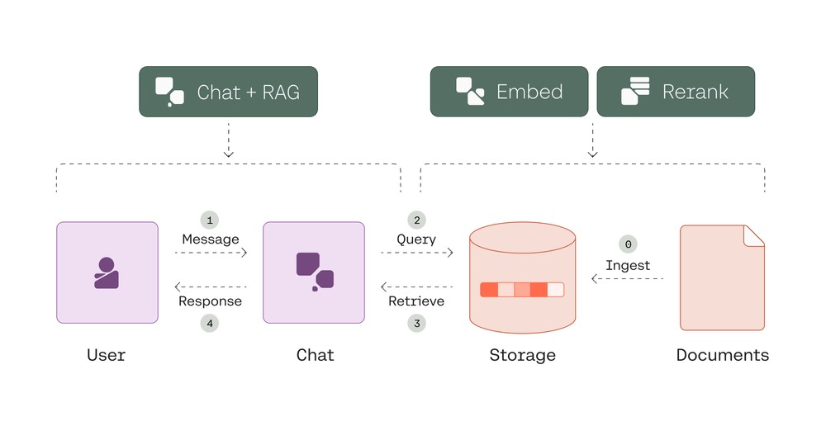
System Design & Implementation

Slide 12
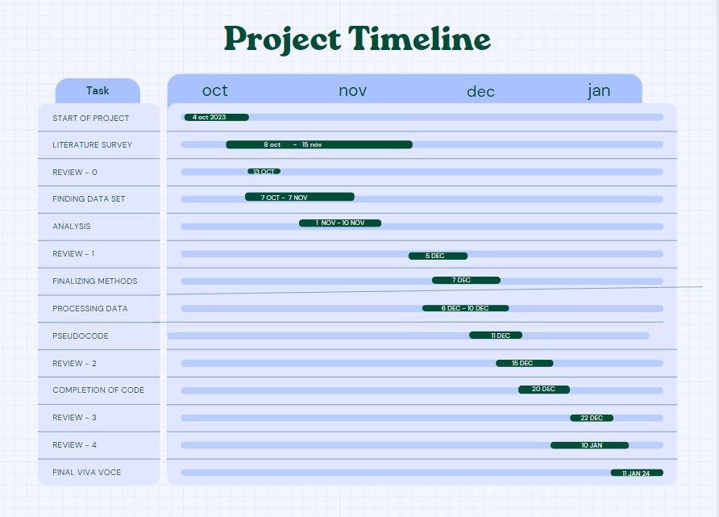
Timeline of Project

Slide 13
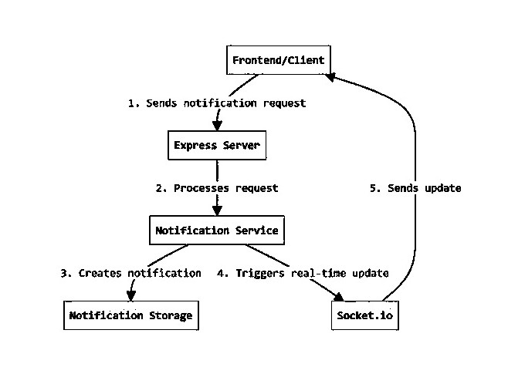
Architecture :

Slide 14
Outcomes / Results Obtained
1.Enhanced User Interaction
Interactive Features:
* Chat Bot Interaction
* Video Support Implementation
2:Improvement in Information Accuracy
* Real-Time Information Delivery
* Data Integrity and Verification
* Impact on Public Services
3: Increased Accessibility
* Accessibility Compliance
* Broader Demographic Reach
4: Boosted Security and Privacy
* Security Outcomes
* Privacy Enhancements

Slide 15
Conclusion
The "Digital Public Announcement and Chat Bot Systems" project has demonstrably enhanced the landscape of public service interaction. By integrating advanced technologies like AI, real-time communication, and user-centric design, the system has transcended traditional methods of information dissemination. The results show a marked improvement in user engagement, service delivery efficiency, and operational cost reduction, setting a new benchmark for public utilities in digital transformation.
Throughout the implementation, we've seen significant strides in user accessibility and inclusivity, with multilingual support and adherence to accessibility standards broadening the system's reach. Security and privacy enhancements have fostered greater user trust, while the system's scalability has proven its capability to adapt to varying loads, ensuring reliability when it matters most. This project not only meets but often exceeds the objectives set forth, contributing to both immediate operational enhancements and long-term sustainability goals.

Slide 16
References
Smith, J. (2021). "AI Chatbots in Public Sector Communication". Journal of Digital Transformation, Vol 5, No 2, pp. 45-60.
Johnson, A. (2019). "Real-time Information Systems for Public Transit". Transportation Technology Today, Vol 3, pp. 102-117.
Lee, M. (2022). "Video-based Support Systems in Public Services". Public Administration Review, Vol 82, No 1, pp. 23-35.
Clarke, B. (2020). "Interactive Digital Signage for Public Announcements". Digital Signage Digest, Vol 14, No 3, pp. 67-80.
Brown, E. (2023). "User Experience in Digital Public Services". UX in Government, Vol 9, No 4, pp. 12-25.
Davis, K. (2021). "Accessibility in Digital Government Services". Accessibility Studies, Vol 18, No 2, pp. 55-70.
Martinez, L. (2022). "Security in Public Digital Systems". Cybersecurity Journal, Vol 17, No 1, pp. 33-48.

Slide 17

Thank You

